Slide 1

Client On-Boarding (COB) Overview
Service Leader: Sujal Popat Business Owner: Nancy Newcome
Service Champion: Shabsi Kenig L3 Manager: Ali Quraishi
Giridharan Gopalsamy
Business Theme PM : Dave Lombino, Service PM : Arunkumar Santhalingam
Shashank Bhargava

Slide 2
Agenda
Service Overview:
Client and End customer usage
Service Context: Context Diagram in relation with other services
Key End -2- End flows in different views (sample diagrams)–
Business, Services,
Applications, data,
Operational, User Interface (screens)
Architecture Diagrams
Context (Current/Future State)
Data Flow
List of (Key) Applications
Glossary of Terms
Review Questions

Slide 3
Service Overview
Service Description
Pershing’s Client On-Boarding (COB) solution goes beyond “new account opening” to help Investment Professionals bring prospective customers into their firms by including what is typically “subsequent processing” into one seamless process. Rooted on customer feedback, Client Onboarding is intended to provide a simple yet powerful tool which reduces NIGO errors and improves account funding percentages while delivering an efficient process (including eSignature integration) to welcome clients to the firm. COB is an interface to IBD Users/clients to a) Opening/Updating an account and b) to Configure the new account opening fields for account opening interface. COB promotes front-office initiation by providing multiple entry points and offers user friendly account opening experience to advisories COB reduces time taken and # of clicks to enter new account information by providing a single screen for data entry. COB reduces even the data entry work by using existing data from internal Pershing systems and/or 3rd party applications, including CRMs. COB offers services to create account from external systems too like Envestnet and Salesforce Draft creation using APIs exposed via Pershing Webservices. COB offers advisors/reps to SSO from external tools like Salesforce and Cetera (client hosted applications).
Business Value
Few of the features of Client On-Boarding are Single page and/or Guide Me based Account Opening Wizard Save as Draft IBD/OFF/Account-Registration Type level Field Control Custom Fields Prefill exiting accounts and parties Accuont Funding, eSignature and MI Integrations. CASH Sweep Retirement Plan Linking Household and Selectlink Integration Salesforce/Envestnet Draft creation and SSO QAS Address Validation Compensation Splits / Advisory Splits
Channels
Netx360 (.Com and .Net portals), NXI (Netx Investor), External APIs (Envestnet, Salesforce via Pershing Webservices), Internal APIs (APIs for Draft creation and COB Configuration)
Notes:
Introduce and define Service, highlighting it’s business value, and describe it’s sub-services at high level.
Refer to some Client segments, and solution categories in Service Catalog (https://myshare.bnymellon.net/sites/ctsgwm/ba/Site%20Pages/Service%20Catalog.aspx)
Please feel free to add additional slides to cover some of the relevant questions.

Slide 4
Account Opening and Management - Lifecycle Processes
Standard Business Process Categories | COB Account Opening and Management
Pre-investment
Account Management | X
Payment Initiation
Pre-Trade
Trade
Post-Trade
Clearing & Settlement
Asset Servicing
Cash Management
Reconciliation
Collateral Management
Settlement
Pricing/Risk/Reporting
Regulatory Reporting - Investor
Regulatory Reporting - Issuer
Notes:
Identify where your service fits in Standard Business lifecycle process categories or what standard process categories does this service supports, e.g. in the sample above Trade processing fits in pre-trade and trade process categories.
Describe what standard lifecycle processes does this service provide or provides functions are used in standard processes.
For details of functions in standard processes refer to https://www.iso20022.org/sites/default/files/documents/dashboards/dashboard_securities_business_processes.pdf and
https://www.iso20022.org/sites/default/files/documents/dashboards/dashboard_payments_business_processes.pdf

Slide 5
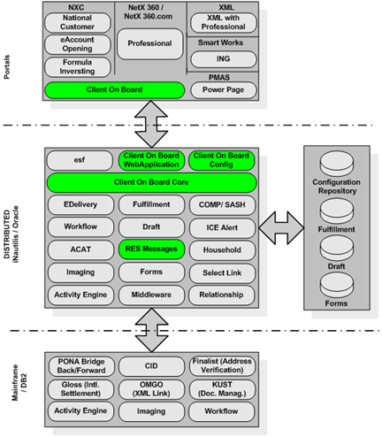
Service Context Diagram
Notes:
Provide a Service context diagram showing Main/Topic service as central point and how it interacts with other services, highlighting key information flows between Main/Topic service and other services.
Speak about the information flows.
Key points when creating this diagram:
Each block must represent a service. The central block must show main/topic service with it’s sub services.
Other services can show specific subservices as it relates to specific functions/interactions on the diagram.
Information flow must show type of Data in business terms and direction of flow.

Slide 6
Key Functions or Subservices
Guide Me and Help Text Wizard
Walks user through new account opening process
Save as Draft
IBDs can save the account as draft and later submit the account
IBD/OFF/Reg. Type level Field Control
Where IBD Admins can control the display preferences and default values configurations for UI Sections and Fields
Custom Fields
Additional fields each IBDs can setup during Account opening
Prefill exiting accounts and parties
Prefill the new account with the data from the existing account and parties
Account Funding, eSign and MI Integrations
Seamless integration of parallel Managed Account opening & facilitating the eSignature and Funding during opening
Integrated Equifax
Which enable users to view their Credit Reports
Single Point of Entry
Where both US and Non-US Settlement Instructions can be setup
QAS Address Validation
Account level address verification with USPS address
Notes:
Sample provided is from Billing. Highlight core vs non-core capabilities of the service.
Refer to Service Catalog for Key functions or sub services https://myshare.bnymellon.net/sites/ctsgwm/ba/Site%20Pages/Service%20Catalog.aspx.
Describe key functions/subservices and talk about any roadmap efforts to move non-core capabilities to other services.
At the minimum, mention and explain subservices on service catalog. In addition, expand on that list to include functions that the service provides but are not on service catalog, as well as functions the are provided by similar service in the industry and may not be supported currently by the service and highlight these.

Slide 7
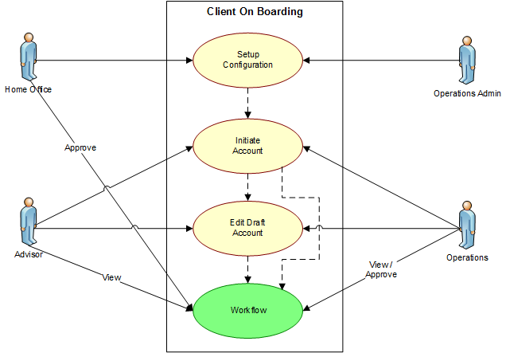
User Model and Key Use Cases

Slide 8
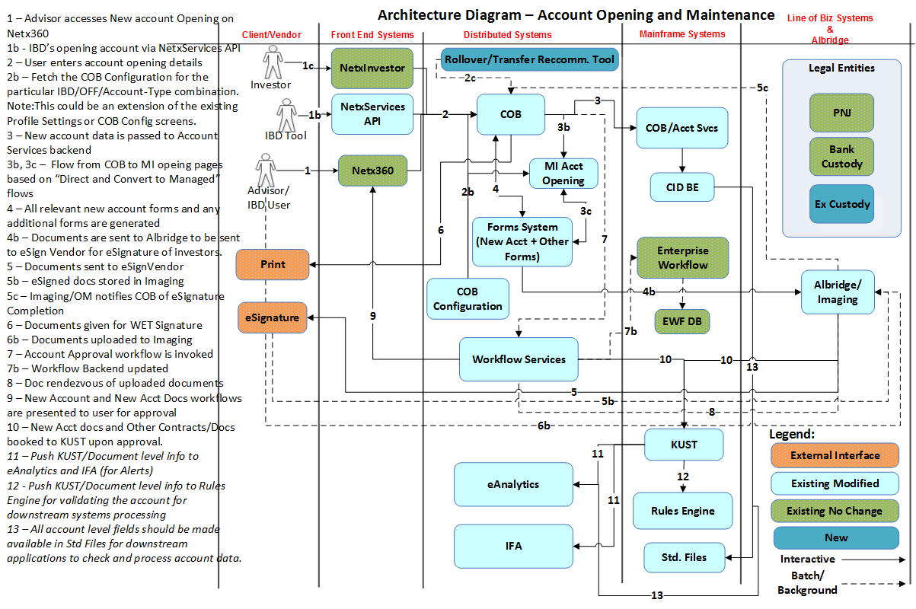
Business Service End-2-End Flow
Notes:
Provide End to End Flow of Key process of the service highlighting the role of Topic Service (e.g. Trade processing in sample) in business terms.
Repeat this slide for each Key Flow, and product (Equities, Fixed income etc.) of the service, if flows are different.
Key points when creating this diagram:
Swim lanes must represent services or external entity name e.g. Client, Investor, Settlement Agency etc.
Each activity must specify details in business terms.
Align activities to standard lifecycle processes (slide #4), and reflected in top header
Interaction/flow between activities must specify data in business terms and also of direction of data flow.
Highlight the swim lane(s) of Main/Topic service.
Remember to number the activities

Slide 9
Glossary
COB – Client On-Boarding
IP – Investment Professional
IBD – Introducing Broker Dealer
RR – Registered Representative
RIA – Registered Investment Advisor
OFF – Office
PONA – Pershing Online Name and Address
EMS – Entitlements Management System
Notes:
Provide a list of key business terms and any abbreviations/acronyms used in the presentation or frequently used in service .

Slide 10
Helpful links
COB Wiki : http://wiki.pershing.com/confluence/display/nxo/Client+On-Boarding+System
COB Sharepoint : https://myshare.bnymellon.net/sites/CTSD2/Reengineering%20Services%20(Product)(nxo)/Wiki%20Pages/Client%20On-Boarding%20System.aspx
UAOAcctCust Model : http://wiki.pershing.com/confluence/download/attachments/962887784/UAOACCTCUST+-+Physical.pdf
UAOConfig2 Model : http://wiki.pershing.com/confluence/download/attachments/962887784/UAOCONFIG2+-+Physical.pdf
For more API and Interfacing related documentation refer the Interface Document section under COB Related Details tab in the above COB Wiki.
For more COB Architecture related information, refer to COB Architecture section under COB Related Details tab in the above COB Wiki.
Notes:
Show each of these during presentation and briefly explain each.

Slide 11
Client On-Boarding (COB) - Deep Dive
Service Leader: Sujal Popat Business Owner: Nancy Newcome
Service Champion: Shabsi Kenig L3 Manager: Ali Quraishi
Giridharan Gopalsamy
Business Theme PM : Dave Lombino, Service PM : Arunkumar Santhalingam
Shashank Bhargava

Slide 12
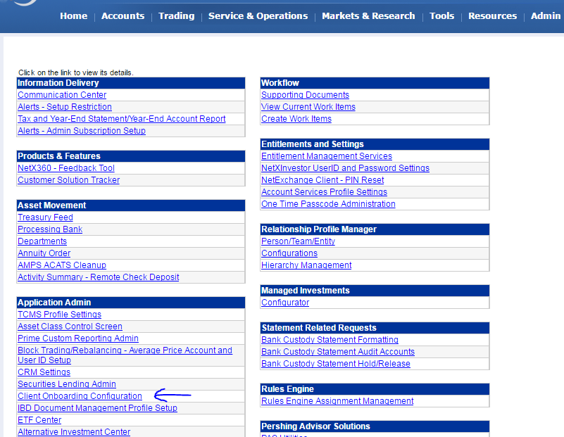
Client On-Boarding Configuration Screens
Notes:
Provide key screens/Front End elements provided by this service, if applicable. If the service has no Front End interfaces, this slide/video can be skipped.
If possible record and provide a short screen capture video explaining Front End Interaction flow of key screens of the service.

Slide 13
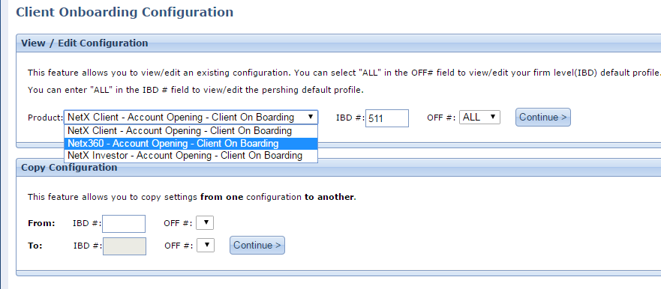
Client On-Boarding Configuration Screens
Notes:
Provide key screens/Front End elements provided by this service, if applicable. If the service has no Front End interfaces, this slide/video can be skipped.
If possible record and provide a short screen capture video explaining Front End Interaction flow of key screens of the service.

Slide 14
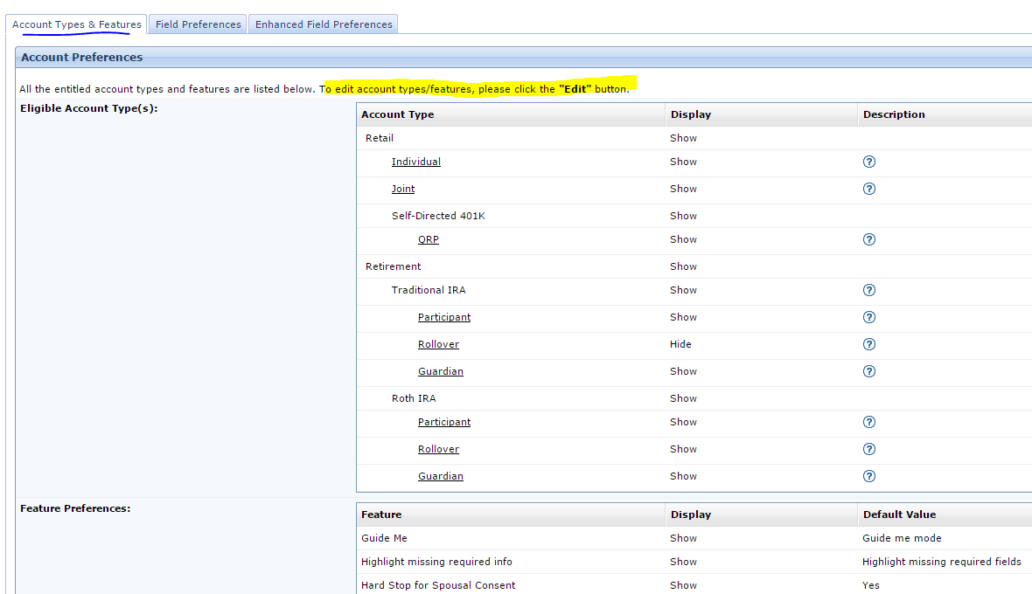
Client On-Boarding Configuration Screens
Notes:
Provide key screens/Front End elements provided by this service, if applicable. If the service has no Front End interfaces, this slide/video can be skipped.
If possible record and provide a short screen capture video explaining Front End Interaction flow of key screens of the service.

Slide 15
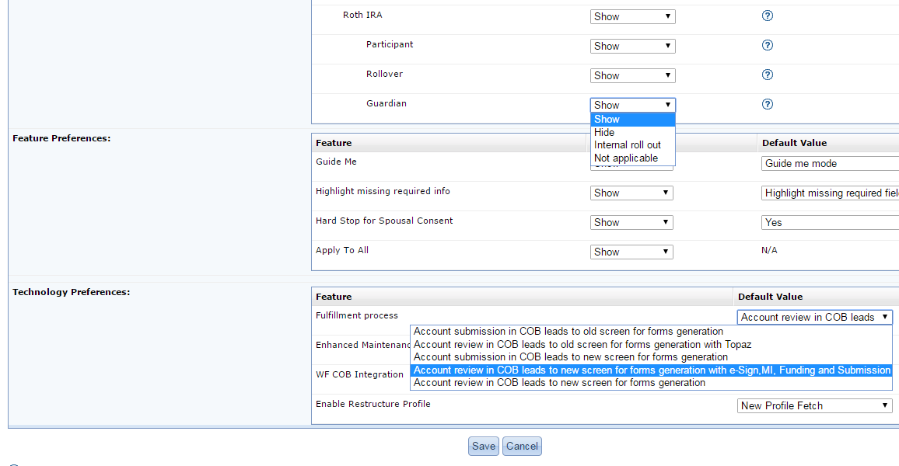
Client On-Boarding Configuration Screens
Notes:
Provide key screens/Front End elements provided by this service, if applicable. If the service has no Front End interfaces, this slide/video can be skipped.
If possible record and provide a short screen capture video explaining Front End Interaction flow of key screens of the service.

Slide 16
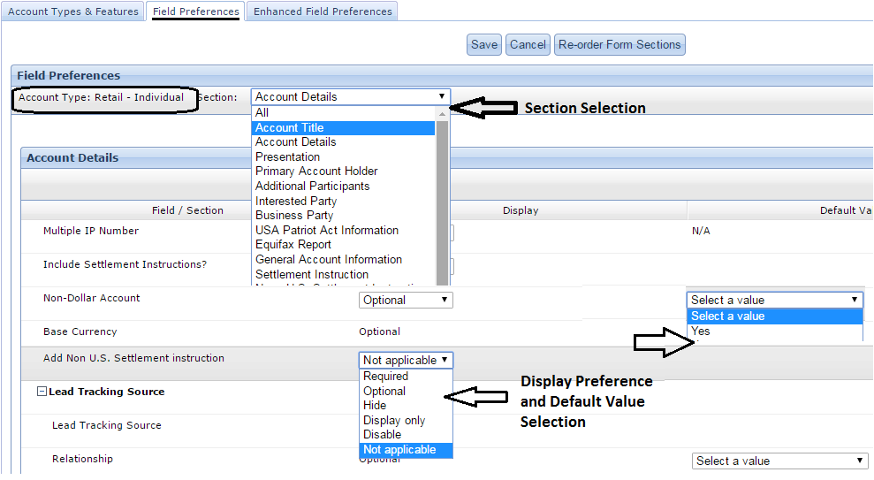
Client On-Boarding Configuration Screens
Notes:
Provide key screens/Front End elements provided by this service, if applicable. If the service has no Front End interfaces, this slide/video can be skipped.
If possible record and provide a short screen capture video explaining Front End Interaction flow of key screens of the service.

Slide 17
Account Basics
All customer account numbers consist of a 3 character alphanumeric office code and 6 digit numeric base account number
X | Y | Z | 1 | 2 | 3 | 4 | 5 | 6
Office Code
Base Account number
Some of the prominent IBDs using COB
NWM ->Northwestern Mutual Investment Services (NMIS)
3CR-> Pershing Advisory Solution
UA1 -> Bank Custody
6CQ -> CUNA Brokerage services
Notes:
Identify where your service fits in Standard Business lifecycle process categories or what standard process categories does this service supports, e.g. in the sample above Trade processing fits in pre-trade and trade process categories.
Describe what standard lifecycle processes does this service provide or provides functions are used in standard processes.
For details of functions in standard processes refer to https://www.iso20022.org/sites/default/files/documents/dashboards/dashboard_securities_business_processes.pdf and
https://www.iso20022.org/sites/default/files/documents/dashboards/dashboard_payments_business_processes.pdf

Slide 18
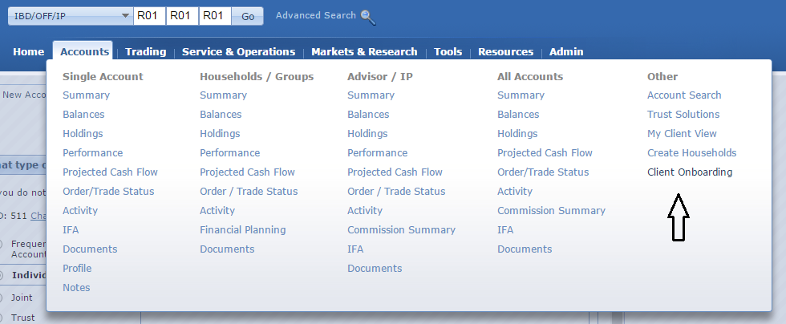
Client On-Boarding Account Opening Screens
Notes:
Provide key screens/Front End elements provided by this service, if applicable. If the service has no Front End interfaces, this slide/video can be skipped.
If possible record and provide a short screen capture video explaining Front End Interaction flow of key screens of the service.

Slide 19
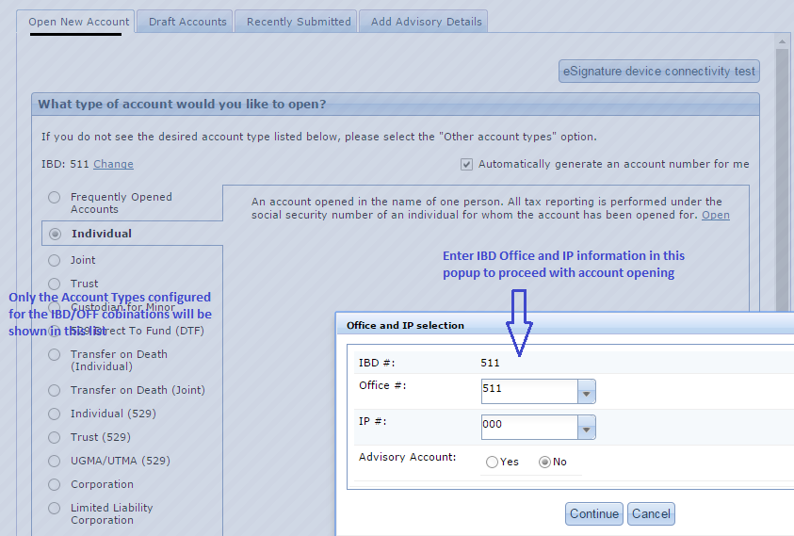
Client On-Boarding Account Opening Screens
Notes:
Provide key screens/Front End elements provided by this service, if applicable. If the service has no Front End interfaces, this slide/video can be skipped.
If possible record and provide a short screen capture video explaining Front End Interaction flow of key screens of the service.

Slide 20
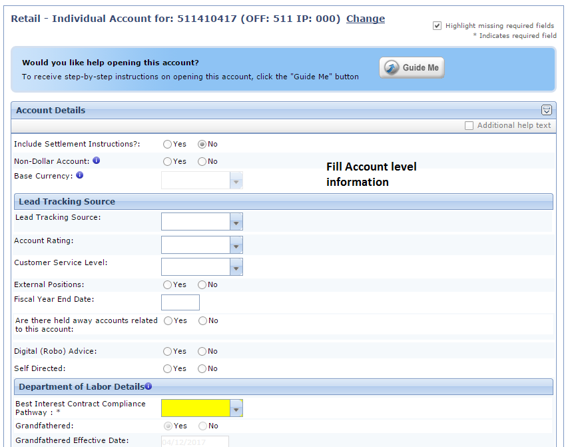
Client On-Boarding Account Opening Screens
Notes:
Provide key screens/Front End elements provided by this service, if applicable. If the service has no Front End interfaces, this slide/video can be skipped.
If possible record and provide a short screen capture video explaining Front End Interaction flow of key screens of the service.

Slide 21
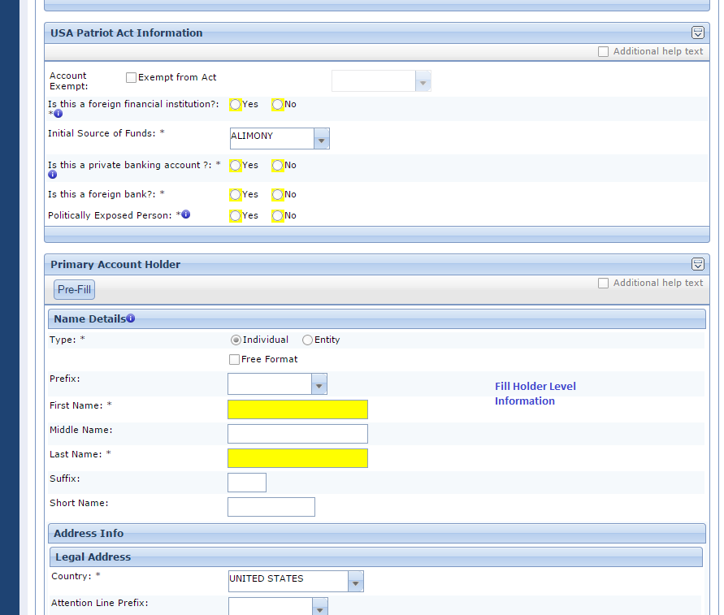
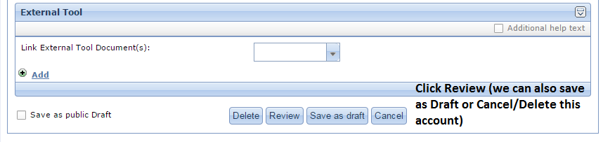
Client On-Boarding Account Opening Screens
Notes:
Provide key screens/Front End elements provided by this service, if applicable. If the service has no Front End interfaces, this slide/video can be skipped.
If possible record and provide a short screen capture video explaining Front End Interaction flow of key screens of the service.

Slide 22
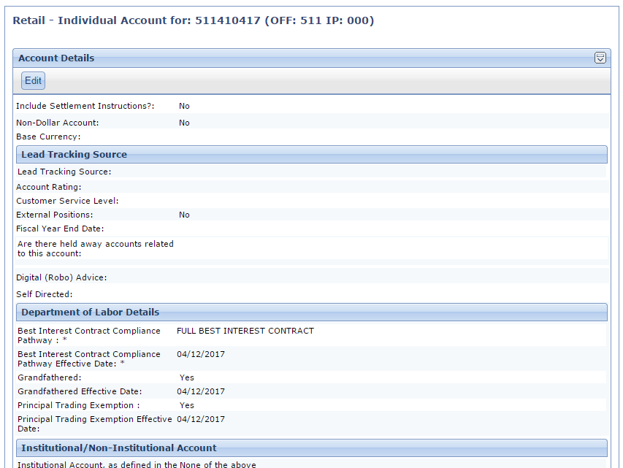
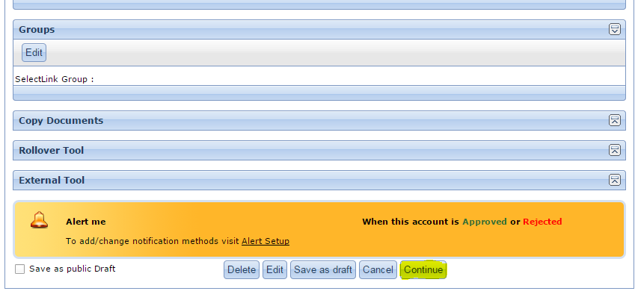
Client On-Boarding Account Opening Screens
Notes:
Provide key screens/Front End elements provided by this service, if applicable. If the service has no Front End interfaces, this slide/video can be skipped.
If possible record and provide a short screen capture video explaining Front End Interaction flow of key screens of the service.

Slide 23
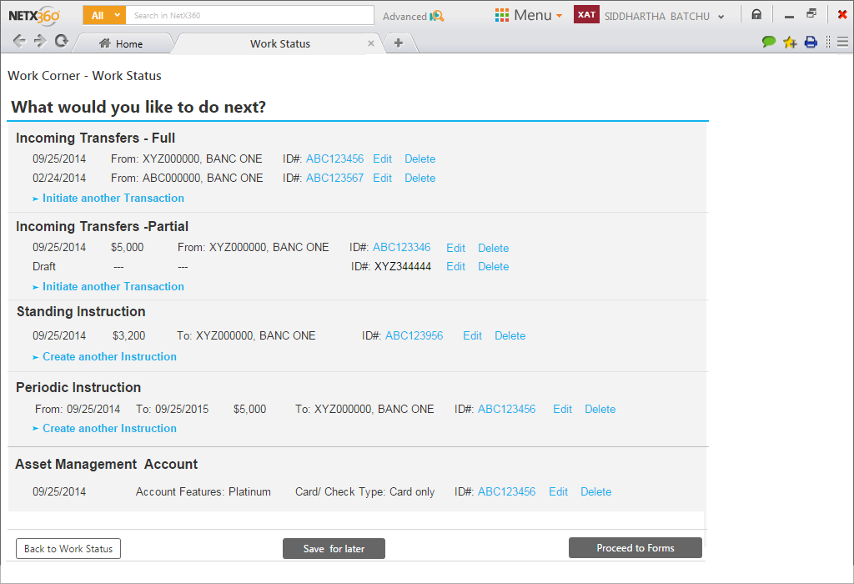
Client On-Boarding - Account Funding Screen
Notes:
Provide key screens/Front End elements provided by this service, if applicable. If the service has no Front End interfaces, this slide/video can be skipped.
If possible record and provide a short screen capture video explaining Front End Interaction flow of key screens of the service.

Slide 24
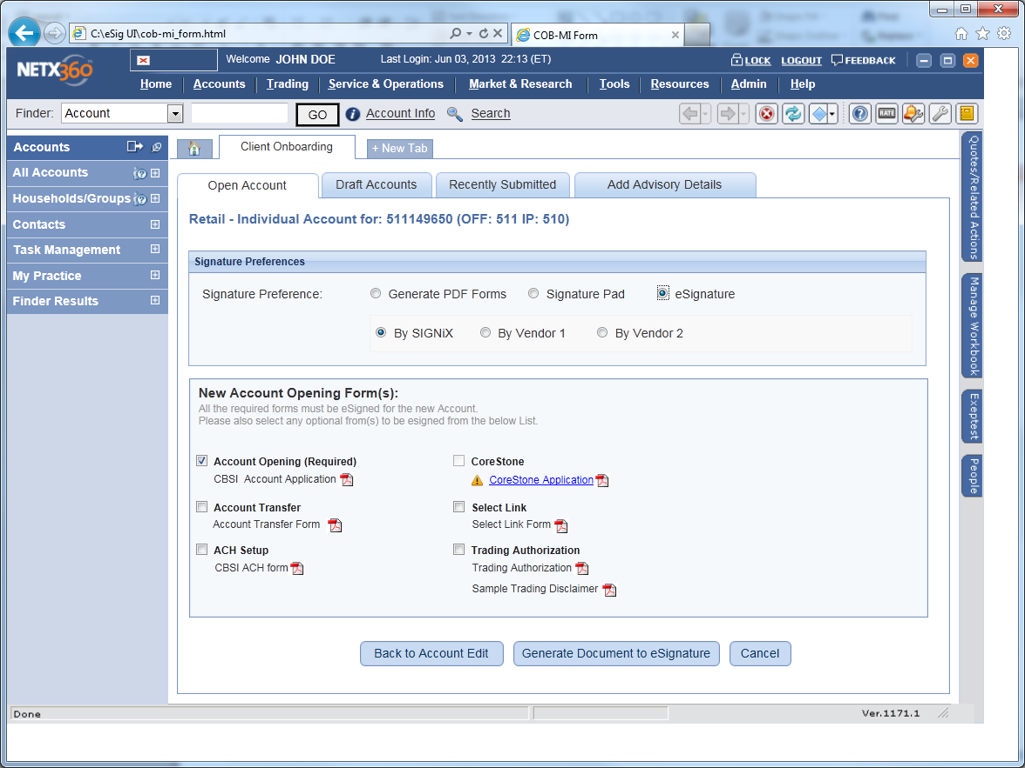
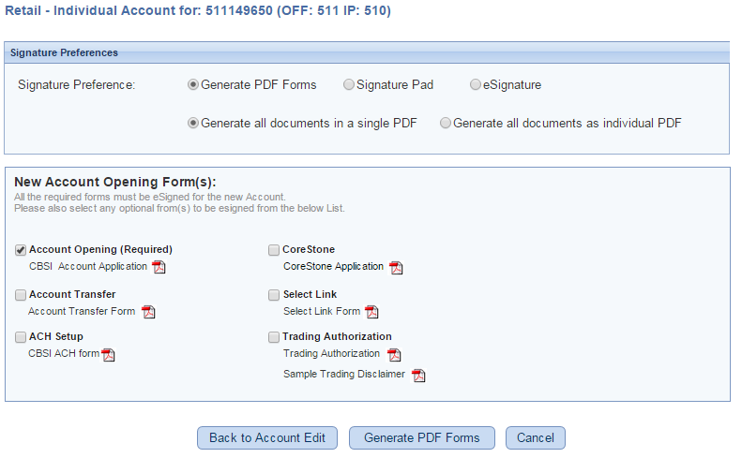
Client On-Boarding – Forms Generation/eSignature Init Screen
Notes:
Provide key screens/Front End elements provided by this service, if applicable. If the service has no Front End interfaces, this slide/video can be skipped.
If possible record and provide a short screen capture video explaining Front End Interaction flow of key screens of the service.

Slide 25
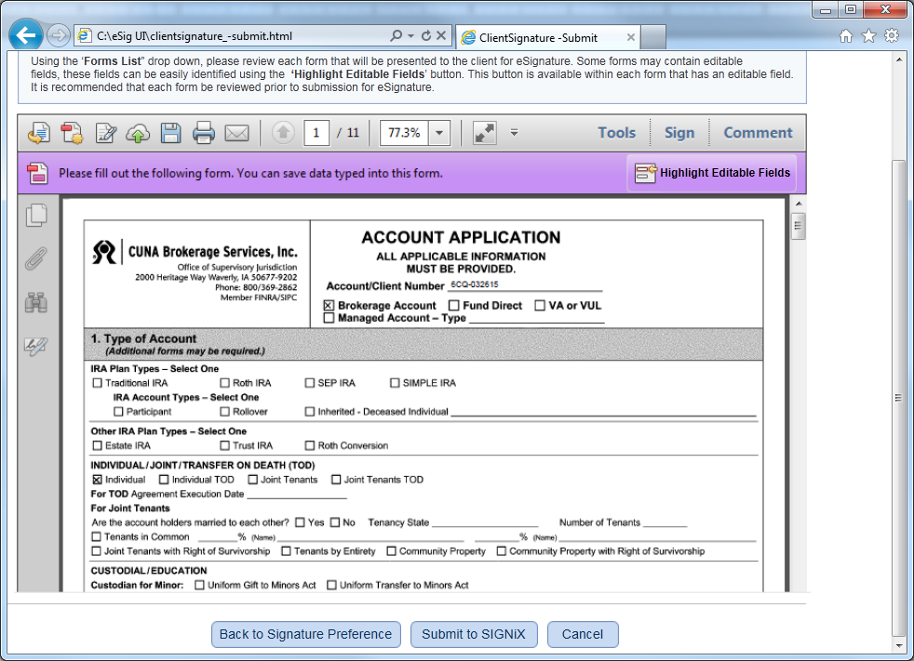
Client On-Boarding – Imaging Screen - Editing PDF Form Fields before Submitting to Signix (eSign Vendor Solution)
Notes:
Provide key screens/Front End elements provided by this service, if applicable. If the service has no Front End interfaces, this slide/video can be skipped.
If possible record and provide a short screen capture video explaining Front End Interaction flow of key screens of the service.

Slide 26
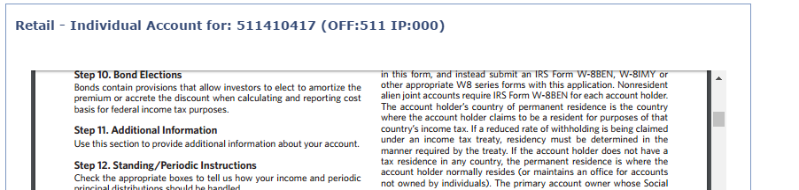
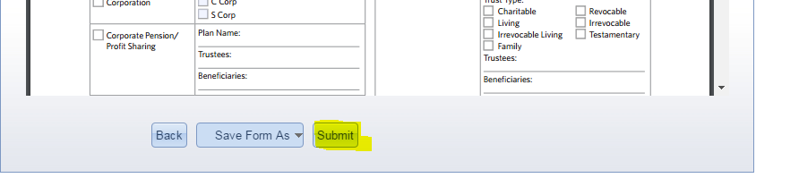
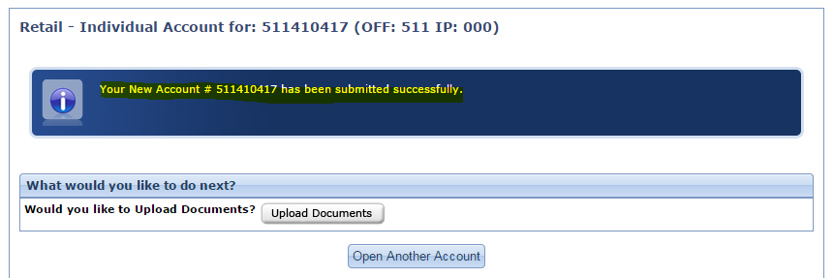
Client On-Boarding – For Non eSign Scenario – Submit Account after forms generation)
Notes:
Provide key screens/Front End elements provided by this service, if applicable. If the service has no Front End interfaces, this slide/video can be skipped.
If possible record and provide a short screen capture video explaining Front End Interaction flow of key screens of the service.

Slide 27
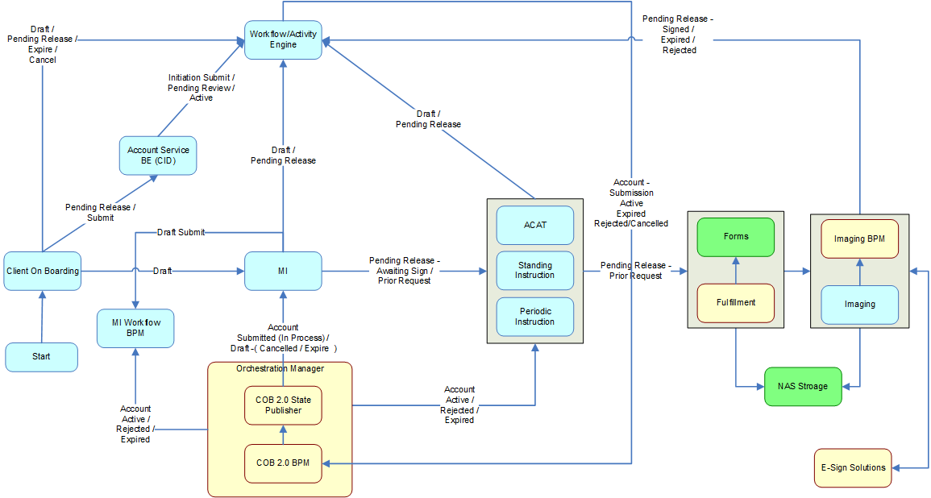
COB Process flow with MI, eSignature and Account Funding Integrations

Slide 28
Globalization
TOPIC | Description | Supported? (Yes/No) | Not Supported
Support 24 x 7 Availability | This means the system must be available for full functionality during data load times of files from various booking entities; including but not limited to: PSL, PSCL, PSAL etc. Data load of one booking entity will not affect data of another booking entities during load times. | Yes
Localization | All presentation Layer data elements adhere to the GBP guidelines for localization, also Globalization guidelines and COE from BNYM Examples: Date, Date Time, Numbers, Quantity datatype fields | No | In pipeline for GBP projects
Multi-Currency | Amount fields and values to be displayed in user preferred or predefined currency setting based on hierarchy. | No
Firm Hierarchy | Support Introducing Firm and/or Legal Entity views on front-end screens. Details available here. | No | Only IBD level hierarchy supported
Global Account Number - NEW | Support Global Account Number on front-end systems and components | No
Notes:
Explain if Service, Sub-Services, Applications support each globalization topic mentioned above. If not, explain why not.

Slide 29
Package Model

Slide 30
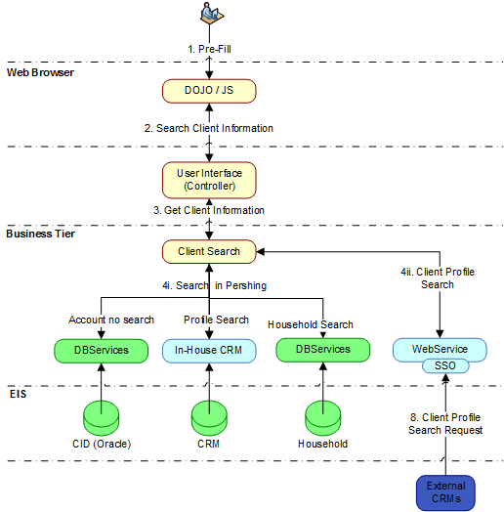
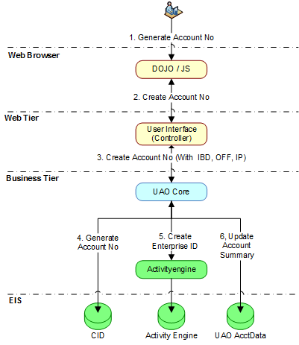
Technology Process Flows
Notes:
Provide and explain the technology stack for the service, or sub-service/application from Front End/API to the OS level, covering all delivery channels.
Repeat the slide for each sub-service/application if the Technology stack used is different for sub-services/applications.
Highlight any Vendor software, packages etc.
Highlight any roadmap/ EOL issues with any of the technology components and any roadmap efforts to replace EOL components.

Slide 31
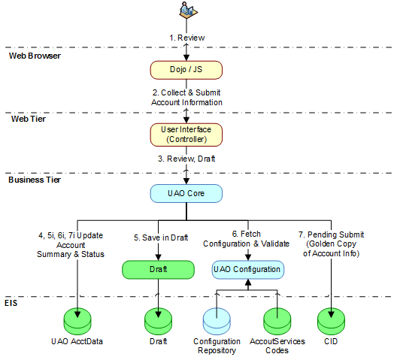
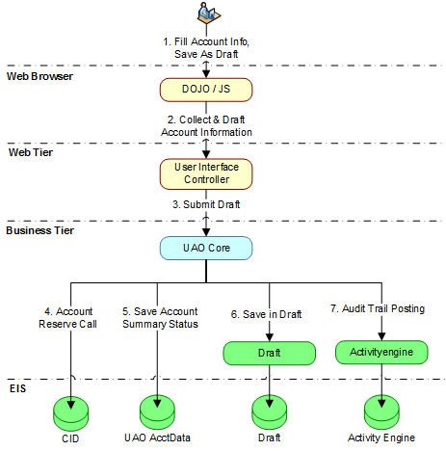
Technology Process Flows

Slide 32
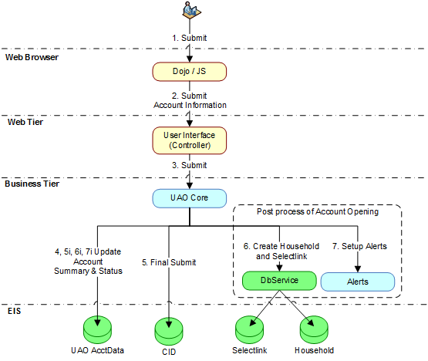
Technology Process Flows

Slide 33
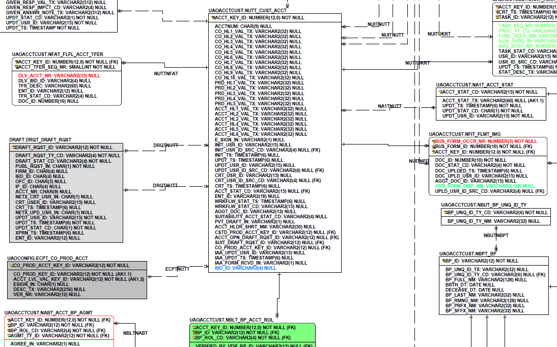
Data Model – UAOACCTCUST Schema
Notes:
Provide Logical and/or physical data models on the service, or sub-service/application(s) highlighting significant entities and relations
Repeat the slide for each sub-service/application if data models are different for sub-services/applications.

Slide 34
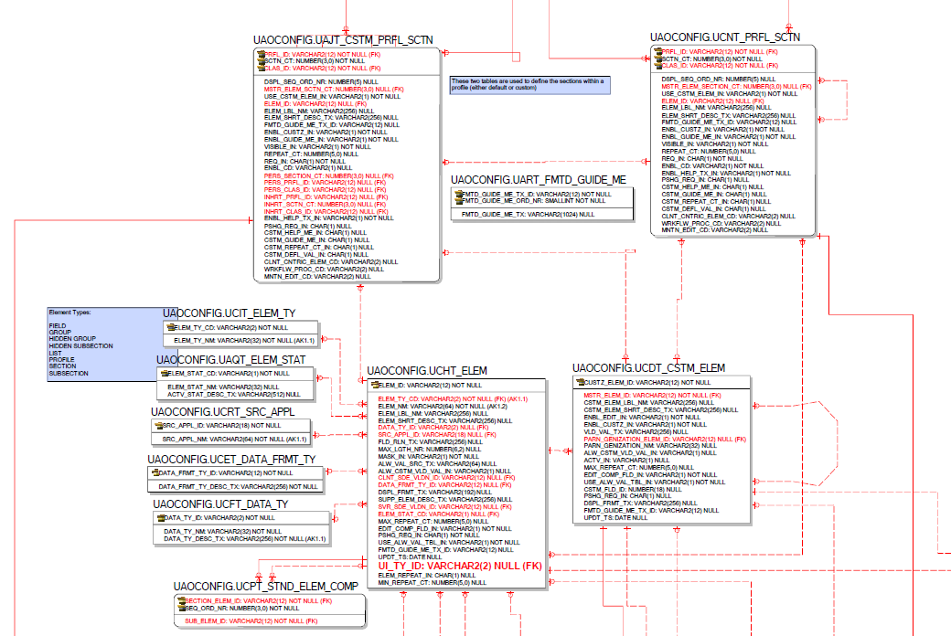
Data Model – UAOCONFIG Schema

Slide 35
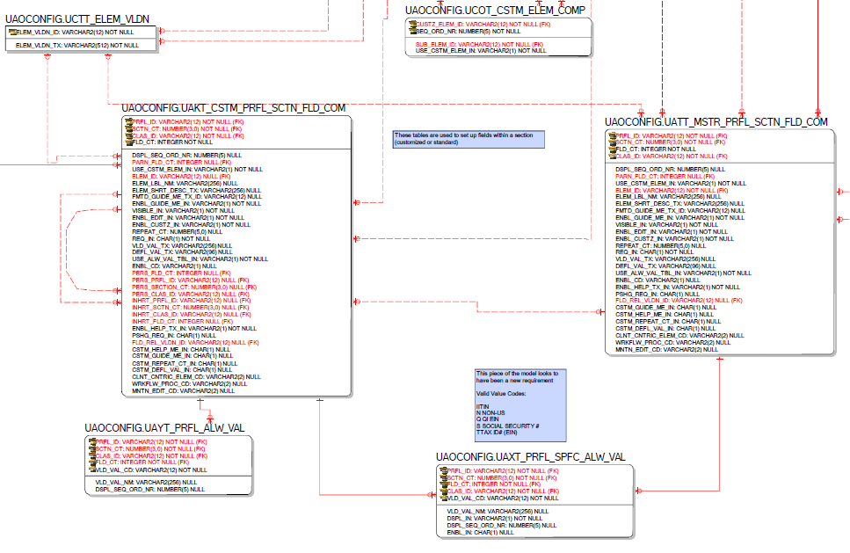
Data Model – UAOCONFIG Schema

Slide 36
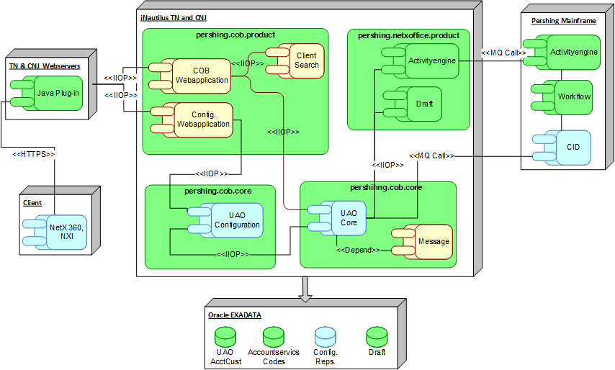
Deployment Diagram
Notes:
Explain the diagram highlighting the points below. Makin sure the font size is legible in normal full screen mode.
Note: Repeat this diagram for each subservice or applications if those apply different deployment architectures.
Provide a diagram illustrating how the executable components of your system will be deployed. Includes all deployed components of your architecture:
Desktop/Web
Middle tier
DB
Batch
Input/output flows
The diagram should exhibit the considerations for
Redundancy/fault tolerance
Scalability
The diagram should include server families( as, db, ws, in, etc) or actual node in the distributed architecture.
The diagram should include any external links, vendor considerations or applications that are involved with the project
If there are any special considerations that should be considered for testing/testbeds a separate diagram should be included to describe this consideration.
The diagram should also annotate modified (new, enhanced or unchanged use) architecture as well as new servers/nodes using the PAD standard notation scheme.

Slide 37
Disaster Recovery Failure points and Recovery Actions
CRITICAL FAILURE POINTS (Critical Use Cases) | USER INTERFACE | NETWORK | DATA-CENTER | APP. SERVER | DB
COB Config and COB Account Opening access Issues |  | 1 | 2 | 3
COB Config and COB Account Opening Memory Issues |  |  |  | 3 | 4
ID (1 – N) | FAILURE ACTION | HOW MONITORED*
1 | Check the network access and the plugin to server routing. | Dynatrace/HPOV
2 | Traffic can be routed to the other DC | Dynatrace
3 | Check the hosts memory and cpu usage and restart the host temporarily and fix the leak for permanent solution. | Dynatrace/HPOV
4 | Check the DB Connections usage and SQL Query time taken for better performance | Dynatrace
Notes:
Repeat the slide for each sub-service/application if the Disaster Recovery procedures are different for sub-services/applications.
Failure Points:
Identify Critical Failure Points within Application – Critical Use Case: List these in the first table
Identify Failure Action – Steps taking when failure occurs – list these in the second table
Failure Actions will be assigned an ID (1 thru N): This number will be added on the Critical Failure table for each layer (User Interface, Network, DC, App Server, DB)
Recovery actions:
How Monitored – Detail how Failure will be monitored.

